Slide 1
2010 – 2011 SENIOR PROJECT
1986 DODGE RAM D100
3.7 LITER SLANT 6
4 SPEED MANUAL TRANSMISSION
229,000 MILES

Slide 2
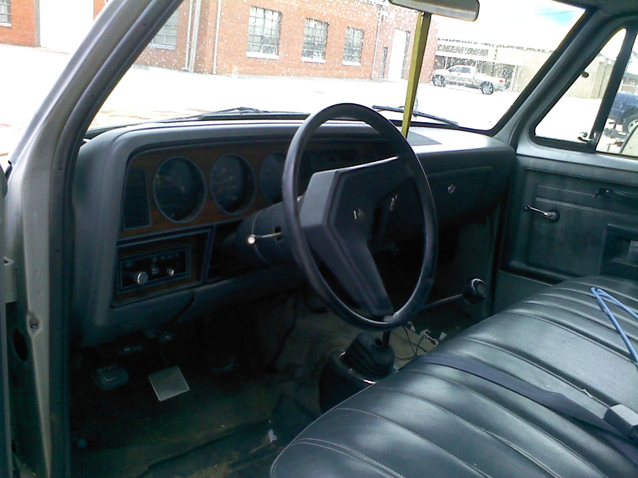
It had an interior…

Slide 3
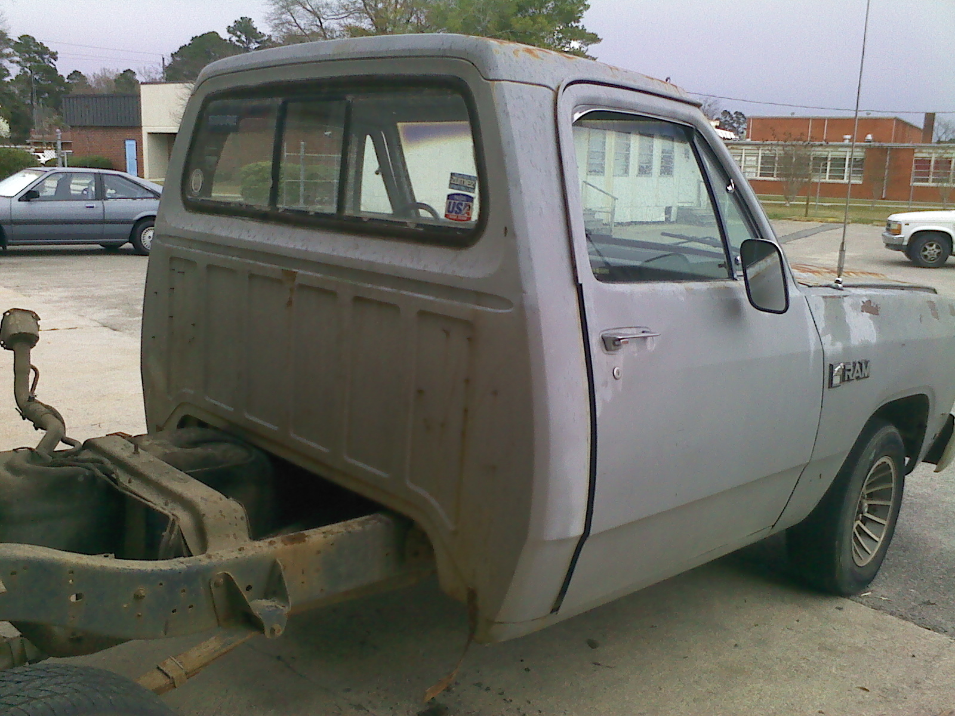
And a roof…

Slide 4
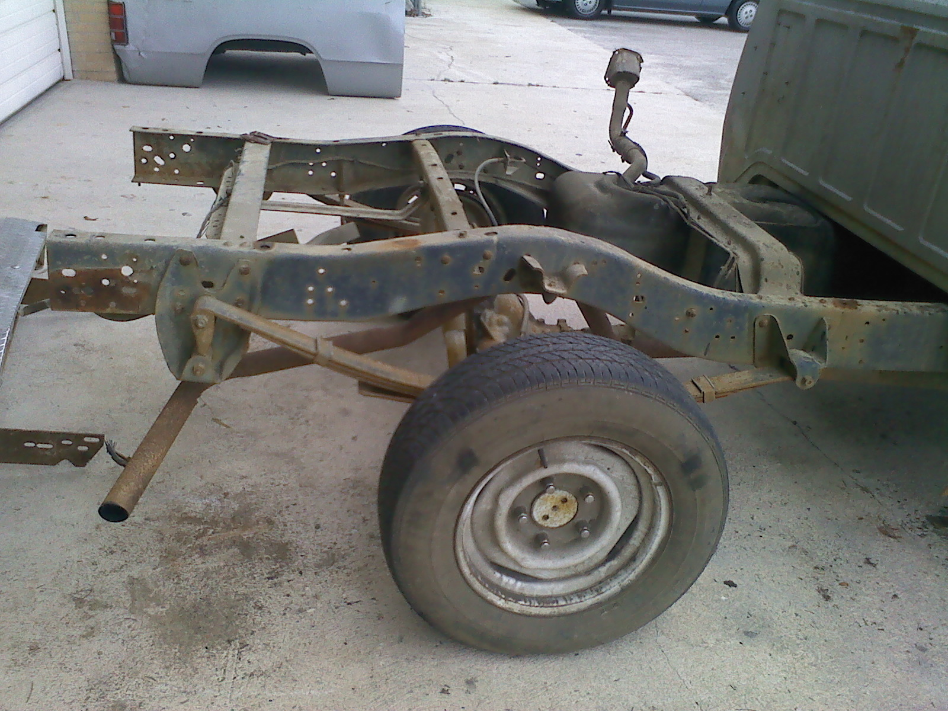

Slide 5
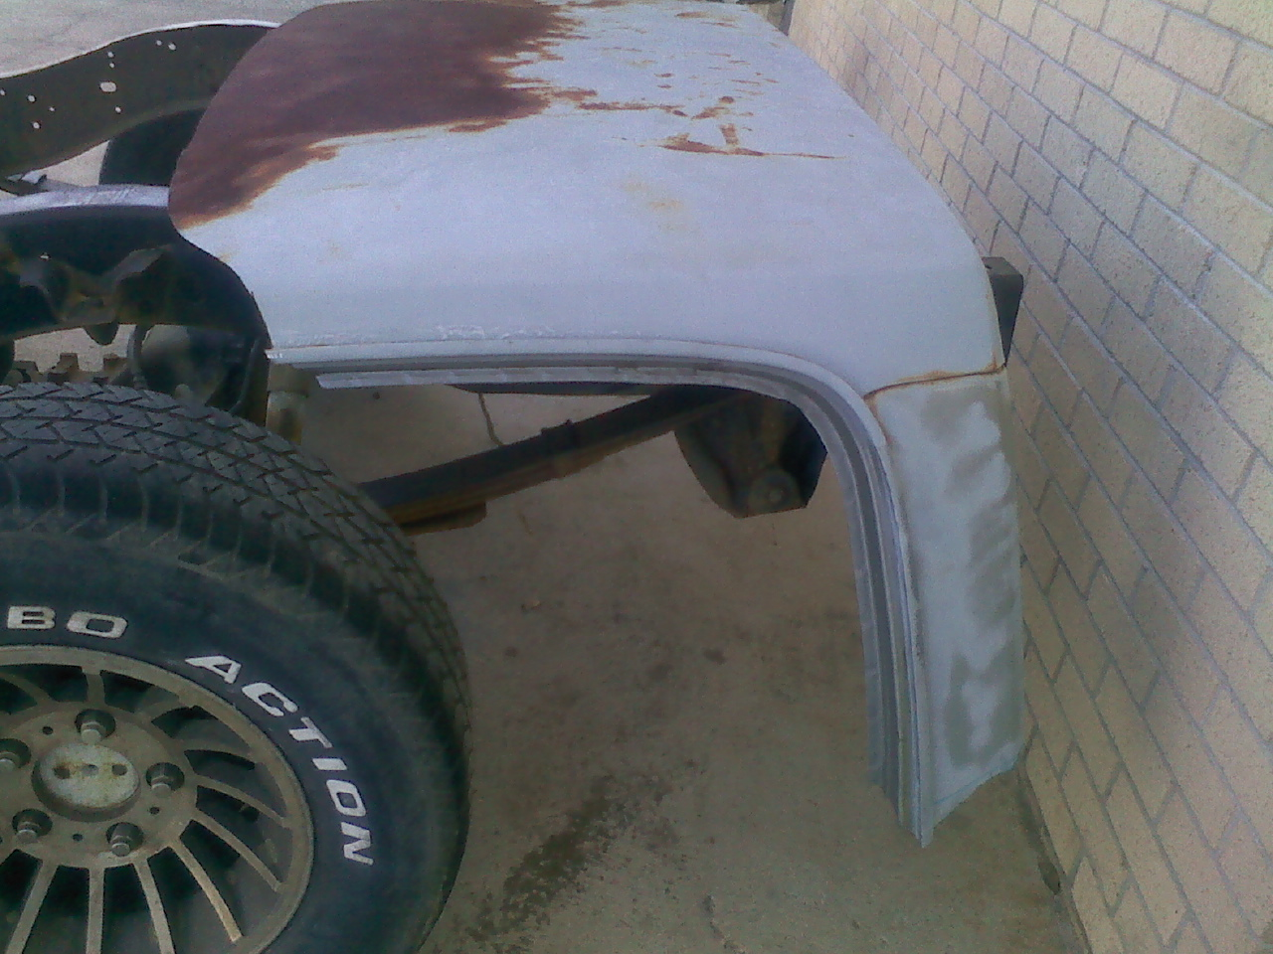
Many hands were laid upon it…

Slide 6
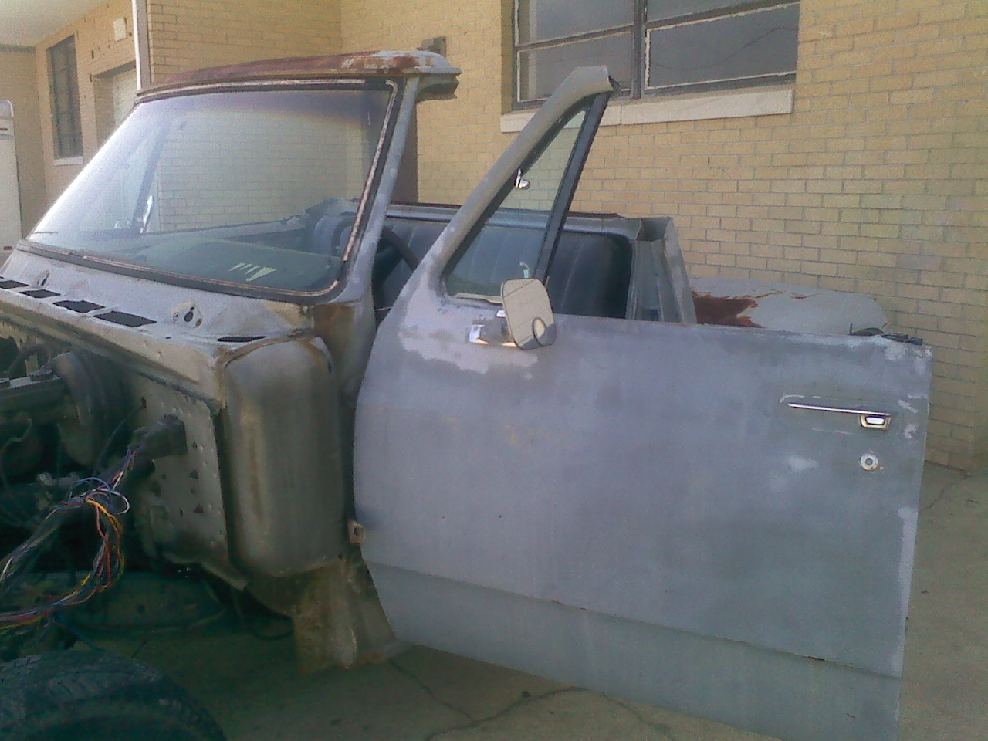
Who needs a roof anyway?

Slide 7
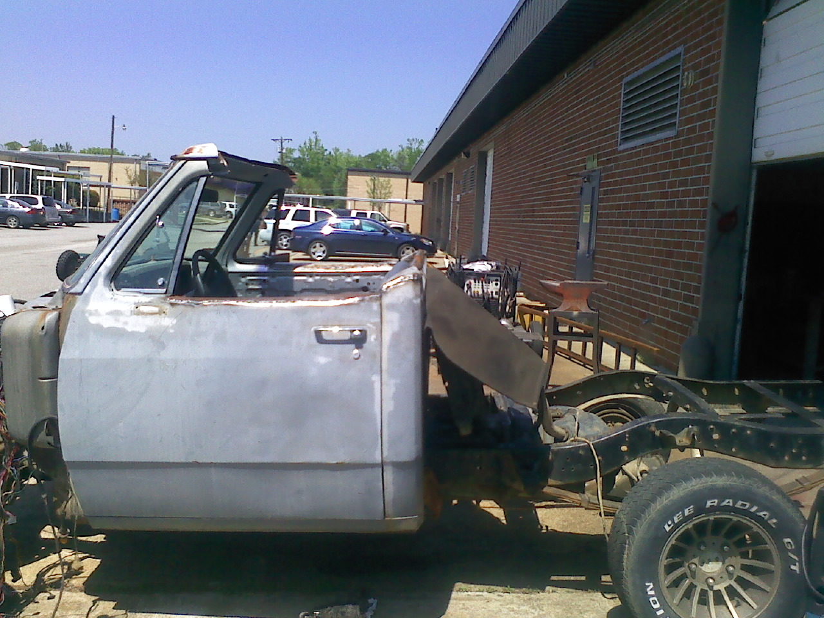
Who stole the bed?

Slide 8
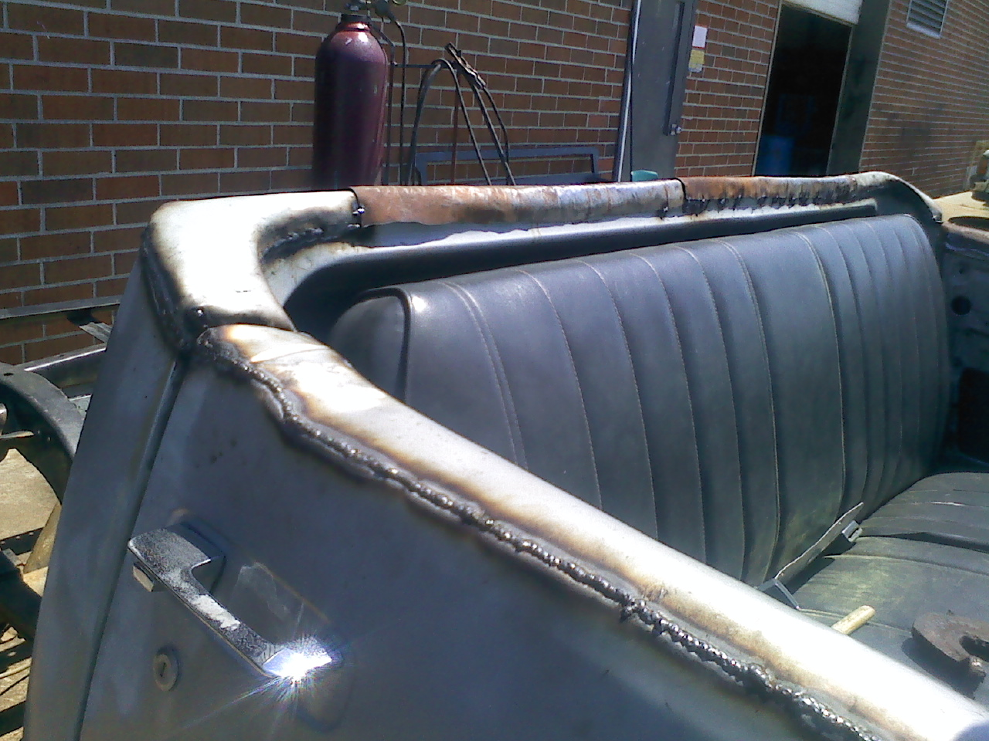
Old roof cut into strips for covering the top edge
Everything used on this truck is reused materials or scraps from this and other shops

Slide 9
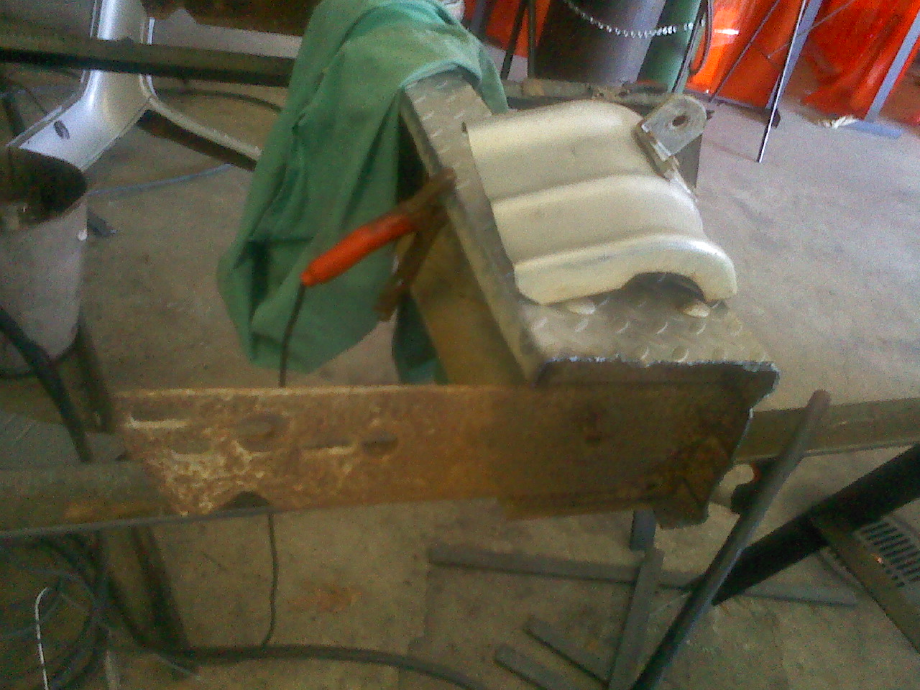
That perfectly good bumper is WAY too long…

Slide 10
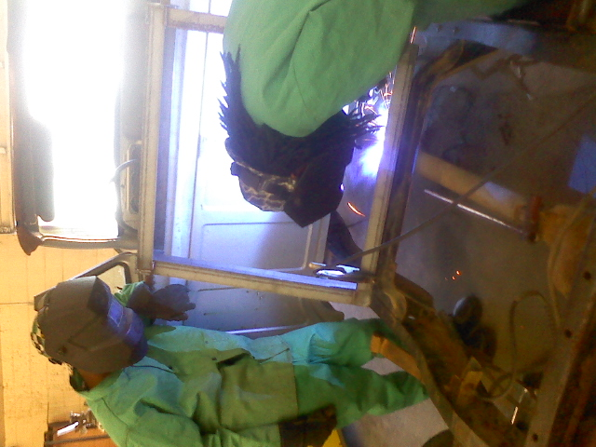
New radiator frame…
              Who needs it in the front anyway?

Slide 11
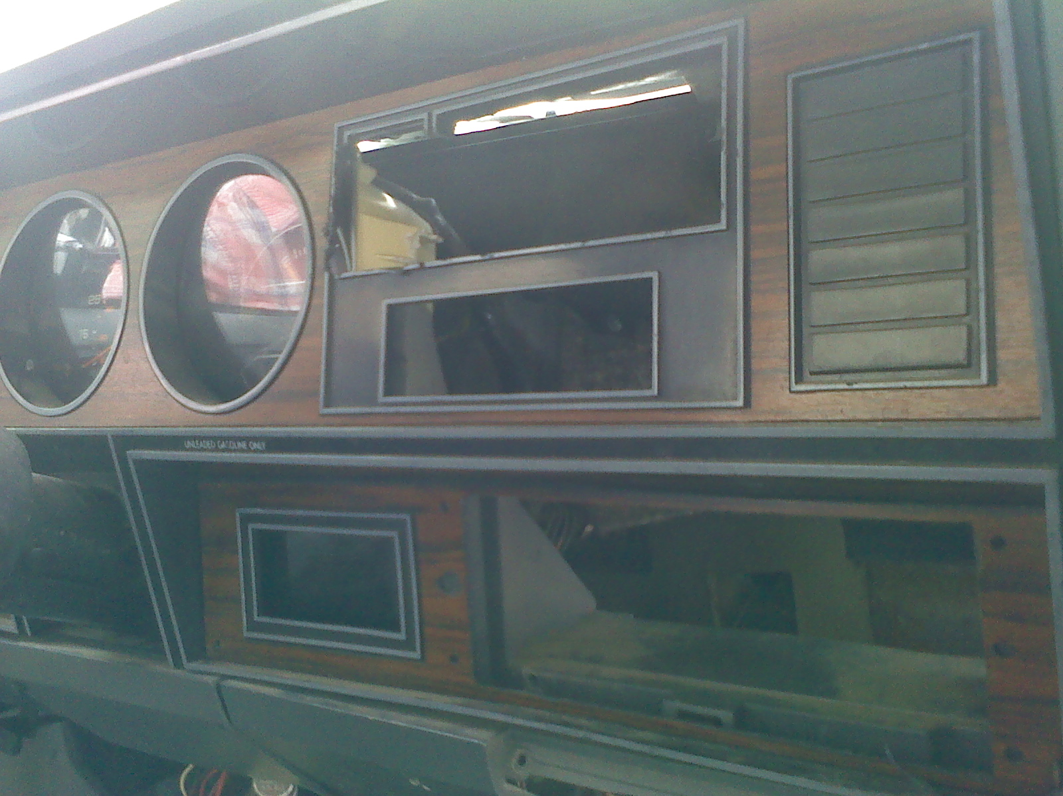
Dashboards are over-rated anyhow…

Slide 12
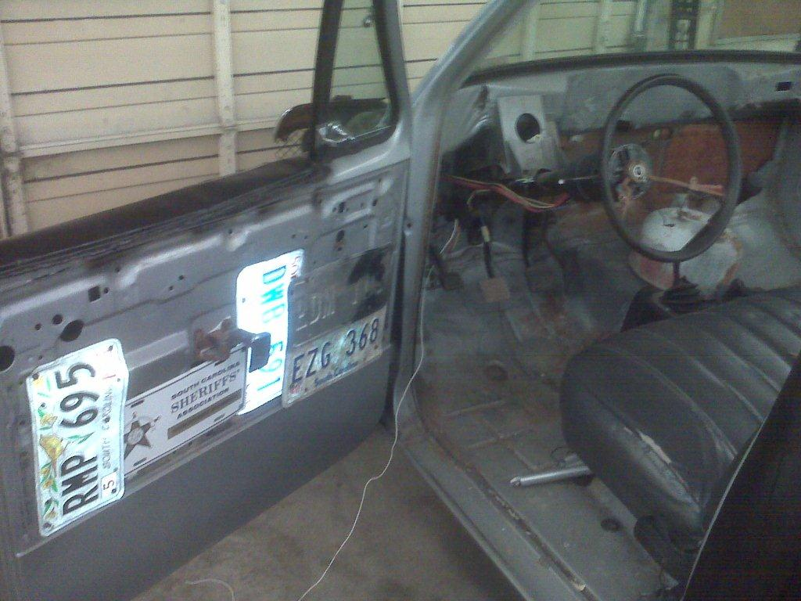
See what I mean!

Slide 13
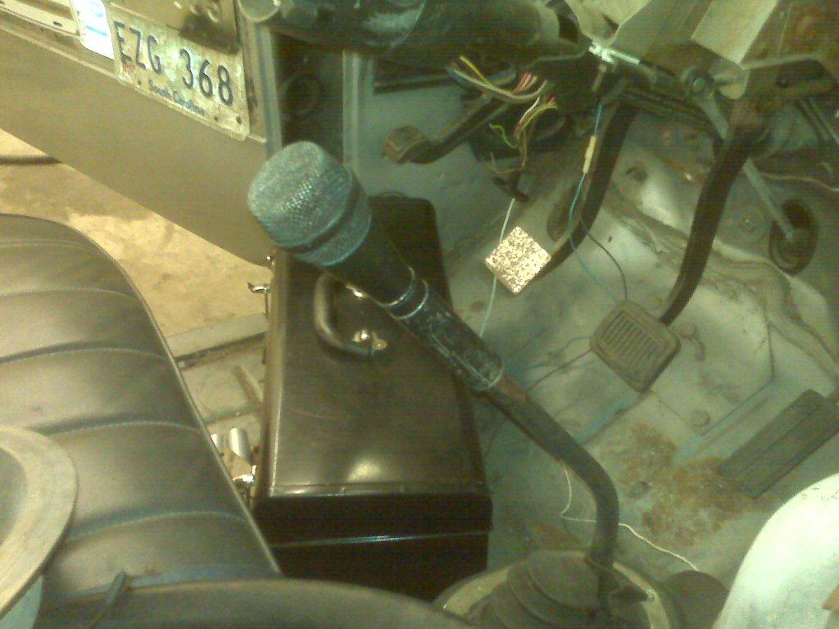
This is the only proper use for a…
SAMSON
MICROPHONE

Slide 14
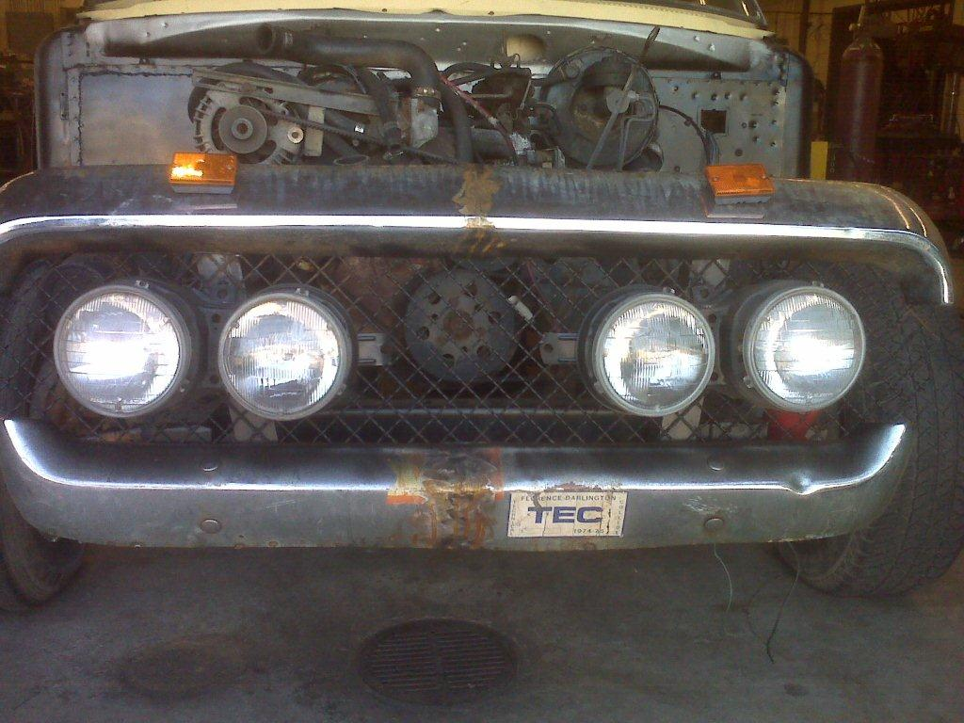
Even Momma says I’m homely

Slide 15
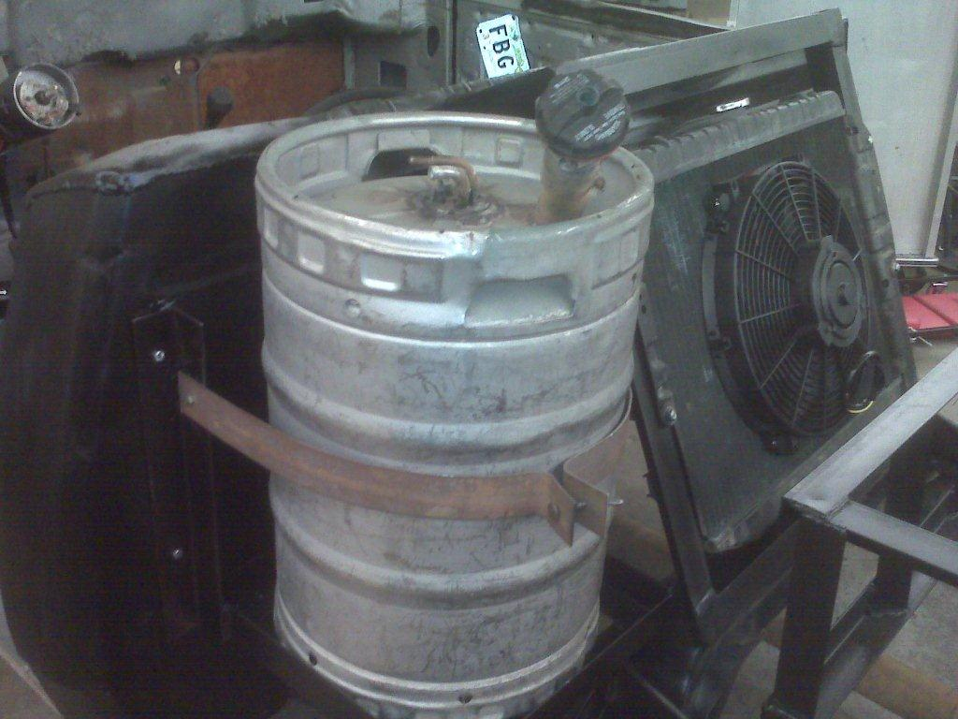
or from either of us!
No, it wasn’t from one of our students…

Slide 16
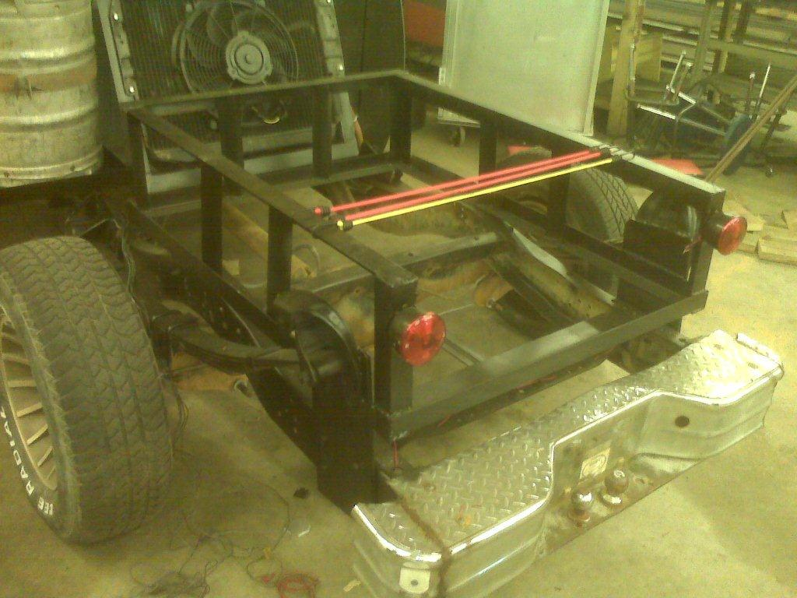
Who needs a perfectly useful truck bed?
…when you can have one of these?

Slide 17
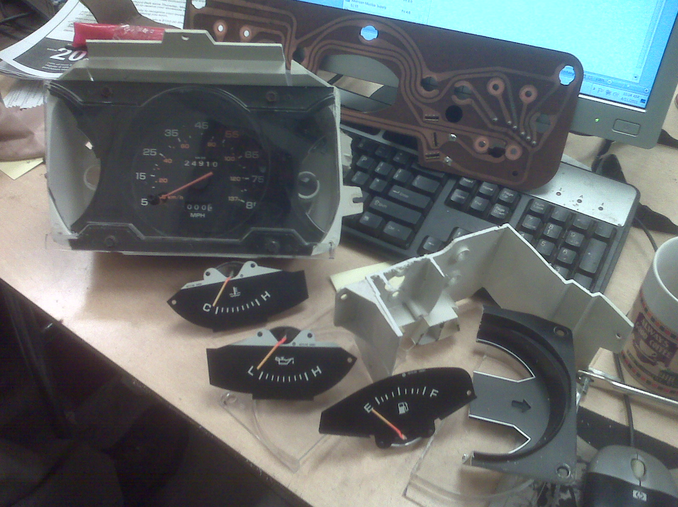
All of those gauges are organized, or useful, either one.
Either way, they’re history

